Slide 1


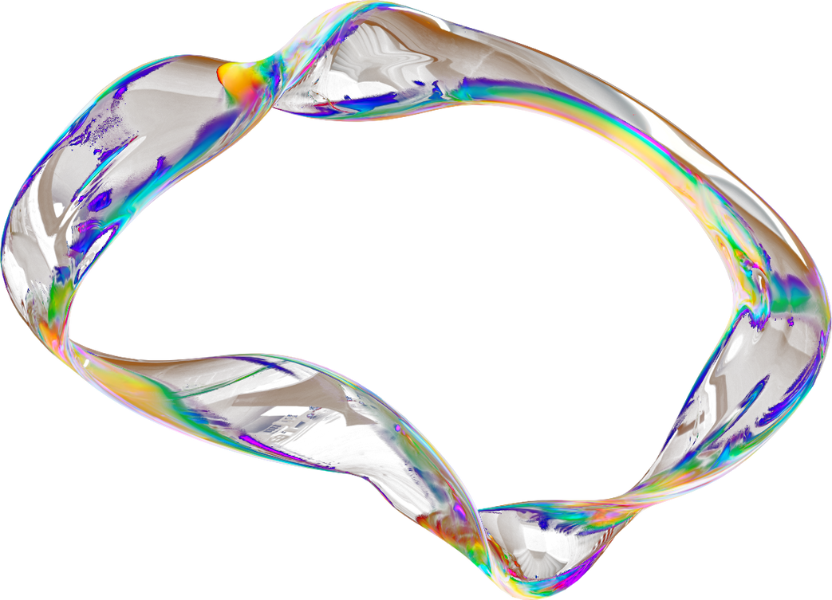

"IntersectMatch: Optimizing Candidate Selection with Joint Semantic and Predictive Filtering"
Presented by:
Madeeha Balouch, Ragad Ahmed, Sarah Elfattal

Slide 2
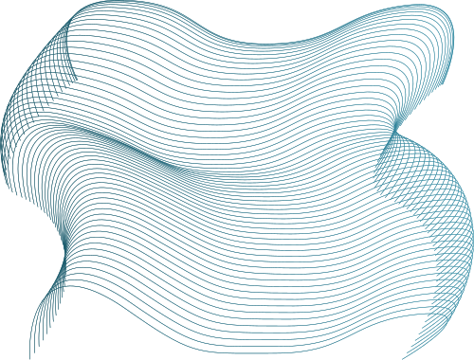

Table of Content
Introduction
Problem Definition
Research Gaps
Methodology
Results
Key Findings
Discussion
Future Work
Demo

Slide 3

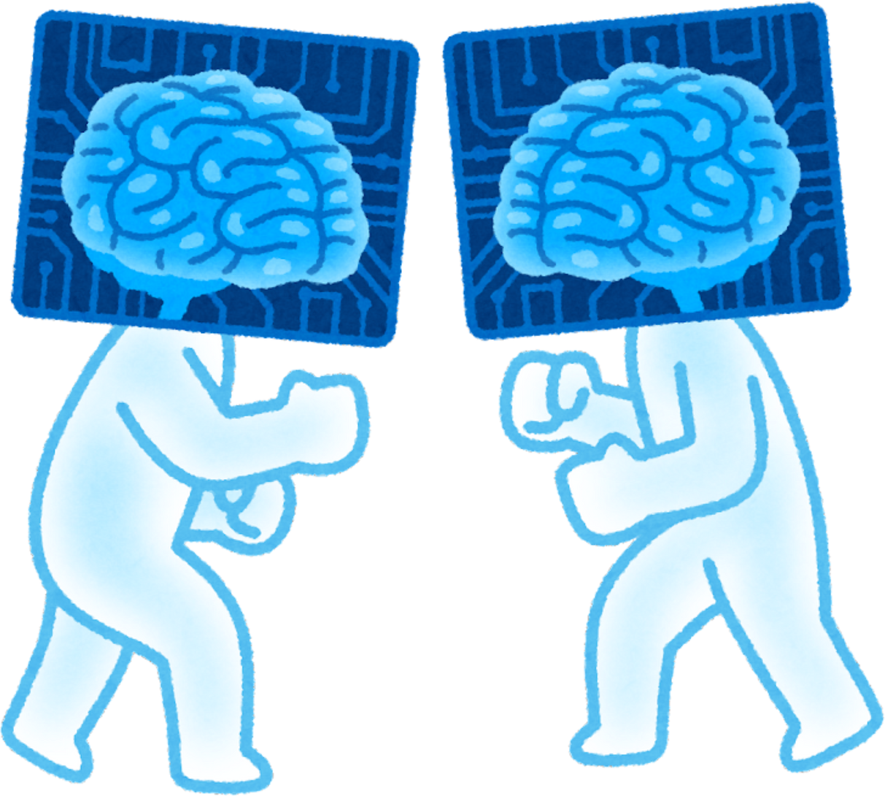
Introduction
Recruitment is increasingly digital and high-volume.
Manual screening is time-consuming, inconsistent, biased.
Organizations need faster, fairer, more scalable systems.
ML and DL are now central in automating resume parsing, ranking, and candidate-job matching.

Slide 4


Traditional hiring methods fail to manage modern recruitment demands.
Bias, inefficiency, subjectivity: result in poor candidate selection.
ML models offer promise but come with trade-offs in fairness and interpretability.
Our goal: assess these models for effectiveness, transparency, and real-world usability.
Probelm Definition

Slide 5

Research Gaps
Embedding Strategy:
Unlike most studies that rely on static embeddings (e.g., TF-IDF), we utilize semantic embeddings (e.g., BERT) for deeper contextual understanding.
Dataset Design:
Existing datasets often include only resumes with labels. We use a richer dataset combining resumes and job descriptions, making it more applicable to real HR scenarios.
Model-Embedding Comparison:
We evaluate multiple models across both static and semantic embeddings to benchmark performance and compatibility.

Slide 6
Methodology

Slide 7
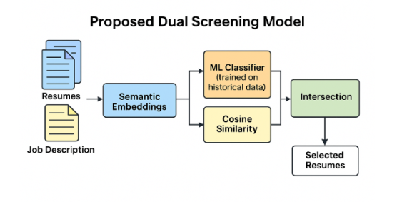
Architecture diagram

Slide 8
Results

Slide 9

Experiments with Semantic Embeddings
ML Classifier | Preprocessing | Semantic Embedding type | Accuracy | Precision | Recall | F1-score
Logistic Regression | Basic (Removal of white spaces and lowering of text.) | Sentence-BERT (SBERT)('all-MiniLM-L6-v2') | 0.5105 | 0.4876 | 0.5105 | 0.4556
Gaussian NB | Basic | SBERT('all-MiniLM-L6-v2') | 0.4423 | 0.4443 | 0.4423 | 0.4413
SVM (RBF Kernel) | Basic | SBERT('all-MiniLM-L6-v2') | 0.5445 | 0.5412 | 0.5446 | 0.5391
XGBoost | Basic | SBERT('all-mpnet-base-v2') | 0.5264 | 0.5435 | 0.5310 | 0.4758

Slide 10

ML Classifier | Preprocessing | Semantic Embedding type | Accuracy | Precision | Recall | F1-score
XGBoost | Basic | DistilBERT | 0.5219 | 0.4977 | 0.5219 | 0.4415
Gaussian NB | Lower case textRemove form text:Email addressNon-ASCII charactersNumbers (keeping those with % $ or year format)Punctuation Stop wordsSMOTE (To handle data imbalance) | SBERT('all-MiniLM-L6-v2’) + Cosine Similarity | 0.37 | 0.38 | 0.38 | 0.36
Random Forest | Lower case text Remove form text:Email addressNon-ASCII charactersNumbers (keeping those with % $ or year format)Punctuation Stop wordsSMOTE (To handle data imbalance) | SBERT('all-MiniLM-L6-v2’) + Cosine Similarity | 0.45 | 0.40 | 0.40 | 0.40

Slide 11
ML Classifier | Preprocessing | Semantic Embedding type | Accuracy | Precision | Recall | F1-score
Logistic Regression | Lower case text Remove form text:Email addressNon-ASCII charactersNumbers (keeping those with % $ or year format)Punctuation Stop wordsSMOTE (To handle data imbalance) | SBERT('all-MiniLM-L6-v2’) + Cosine Similarity | 0.48 | 0.45 | 0.45 | 0.44
XGBoost | Lower case text Remove form text:Email addressNon-ASCII charactersNumbers (keeping those with % $ or year format)Punctuation Stop wordsSMOTE (To handle data imbalance) | SBERT('all-MiniLM-L6-v2’) + Cosine Similarity | 0.43 | 0.49 | 0.43 | 0.44
XGBoost | Lower case textRemove form text:Email addressNon-ASCII charactersNumbers (keeping those with % $ or year format)Punctuation Stop words | GloVe + Cosine Similarity | 0.76 | 0.74 | 0.74 | 0.74

Slide 12

Experiments with Contextual Embeddings
Exp no. | ML Model | Preprocessing | Main Technique | Results
Exp 1. | Gaussian NB | None | TF-IDF | Accuracy: 0.505Precision: 0.57 recall: 0.61F1-score : 0.50
Exp 2. | Complement NB | None | TF-IDF | Accuracy: 0.574375Precision: 0.55 recall: 0.48F1-score : 0.48
Exp 3. | Random Forest | None | TF-IDF | Accuracy: 0.63Precision: 0.61 recall: 0.56F1-score : 0.57

Slide 13
Exp no. | ML Model | Preprocessing | Main Technique | Results
Exp 4. | Gaussian NB | Lower case textRemove form text:Email addressNon-ASCII charactersNumbers (keeping those with % $ or year format)Punctuation Stop words | TF-IDF | Accuracy: 0.5012 Precision: 0.55 recall: 0.59 F1-score : 0.51
Exp 5. | Complement NB | Lower case textRemove form text:Email addressNon-ASCII charactersNumbers (keeping those with % $ or year format)Punctuation Stop words | TF-IDF | Accuracy: 0.55404 Precision: 0.51 recall: 0.44F1-score : 0.44
Exp 6. | Random Forest | Lower case textRemove form text:Email addressNon-ASCII charactersNumbers (keeping those with % $ or year format)Punctuation Stop words | TF-IDF | Accuracy: 0.633 Precision: 0.61 recall: 0.57 F1-score : 0.58
Exp 7. | XGBoost | Lower case textRemove form text:Email addressNon-ASCII charactersNumbers (keeping those with % $ or year format)Punctuation Stop words | TF-IDF | Accuracy: 0.6765Precision: 0.66 recall: 0.62F1-score : 0.63

Slide 14
Exp no. | ML Model | Preprocessing | Main Technique | Results
Exp 9. | Gaussian NB | Lower case textRemove form text:Email addressNon-ASCII charactersNumbers (keeping those with % $ or year format)Punctuation Stop words | TF-IDF + Cosine Similarity | Accuracy: 0.54Precision: 0.58 recall: 0.63F1-score : 0.54
Exp 10. | Complement NB | Lower case textRemove form text:Email addressNon-ASCII charactersNumbers (keeping those with % $ or year format)Punctuation Stop words | TF-IDF + Cosine Similarity | Accuracy: 0.64Precision: 0.64Recall: 0.58F1-score : 0.58
Exp 11. | Random Forest | Lower case textRemove form text:Email addressNon-ASCII charactersNumbers (keeping those with % $ or year format)Punctuation Stop words | TF-IDF + Cosine Similarity | Accuracy: 0.69Precision: 0.68Recall: 0.67F1-score : 0.66
Exp 12. | XGBoost | Lower case textRemove form text:Email addressNon-ASCII charactersNumbers (keeping those with % $ or year format)Punctuation Stop words | TF-IDF + Cosine Similarity | Accuracy: 0.74Precision: 0.72Recall: 0.72F1-score : 0.72

Slide 15
Exp no. | ML Model | Preprocessing | Main Technique | Results
Exp 13. | Gaussian NB | Lower case textRemove form text:Email addressNon-ASCII charactersNumbers (keeping those with % $ or year format)Punctuation Stop words | Word2vec + Cosine Similarity | Accuracy: 0.49Precision: 0.47Recall: 0.48F1-score : 0.47
Exp 14. | Random Forest | Lower case textRemove form text:Email addressNon-ASCII charactersNumbers (keeping those with % $ or year format)Punctuation Stop words | Word2vec + Cosine Similarity | Accuracy: 0.74Precision: 0.73Recall: 0.71F1-score : 0.71
Exp 15. | XGBoost | Lower case textRemove form text:Email addressNon-ASCII charactersNumbers (keeping those with % $ or year format)Punctuation Stop words | Word2vec + Cosine Similarity | Accuracy: 0.75Precision: 0.74Recall: 0.74F1-score : 0.74

Slide 16
Key Findings & Discussion

Slide 17
Static Embedding performs better than Semantic Embedding
Best ML Model:
XGBoost (Accuracy =76%)
Model is not suitable for real world deployment given its low accuracy score
Best Semantic: GloVe
Best Static: Word2Vec

Slide 18
Paper | ML Model | Embedding Type | Accuracy
A Novel Approach for Resume Ranking System Using Machine Learning [1] | Random Forest | static | 100%
Resume Screening Using Machine Learning [2] | Naive Bayes | static | 99%
An ML-based Resume Screening and Ranking System [3] | XGBoost | static | 81.2%
Ours | XGBoost | static | 74%
Ours | XGBoost | semantic | 76%

Slide 19
Future Directions

Slide 20
Key Gaps and Challenges
No Standard Dataset
Existing studies use varied, non-standard datasets—limits comparability
Mismatch with Prior Work
Most datasets lack job descriptions; ours includes them—better realism, less compatibility
Rare Resume–Job Pairing Data
Our dataset is one of the few with resume–job pairs and fit labels—limits benchmarking
No Prior Use of Our Dataset
No past studies use our dataset—external validation remains limited

Slide 21
Future Direction
Standardized Datasets
Develop public datasets with resume–job pairs and detailed fit labels.
Cross-Dataset Validation
Test model on varied corpora to assess generalization.
Domain Adaptation
Apply transfer learning for unlabeled or industry-specific data.
Bias & Fairness Audits
Evaluate model fairness across demographics and language.
ATS Integration
Deploy in real systems to measure recruiter usability and trust.
Enhanced Labeling
Use multi-dimensional fit criteria beyond binary labels.

Slide 22
DEMO

Slide 23
Thank You

